Slide 1
Ashesi University department of business administration BUSA 224: Finance for non-finance managers
Course Faculty:
A. A. Alu

Slide 2
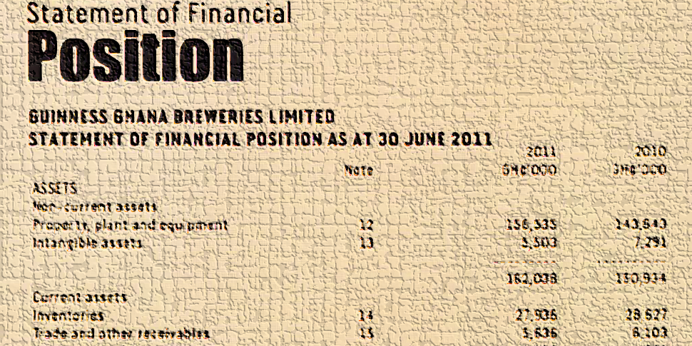
Financial Statements: Components, Users & Elements
Financial Statements
Components
Elements
Users
Required readings:
The IASB’s Conceptual Framework; IAS 1: Presentation of financial statements; Chapter 9 of Dyson

Slide 3
Outline
Components of financial statements
1
Elements of financial statements
3
Users of financial statements
2

Slide 4
Learning Outcomes
Explain
Explain
Identify
Identify
Explain the difference between general-purpose and special-purpose financial statements.
Explain the objectives of general-purpose financial statements.
Identify the elements of each of the components of financial statements.
Identify the information needs of the various users of financial statement.
Explain
Explain the required qualities of users of financial statements.

Slide 5



Components of financial statements
Distinction between general-purpose financial statement and Special-purpose financial statements
Objective of financial statements
Components of general-purpose financial statements
Other reports published in annual reports

Slide 6
Financial statements
Meaning
Financial statements are presented to provide information about the financial position, performance, and changes in financial position of an entity
Objective
A tabulation of names and sums of money extracted from accounting records
Notes:
To achieve this objective, financial statements present information about an entity’s
Asses
Liabilities
Equity
Income
Expenses
Contributions from and distribution of owners in their capacity as owners
Cash flows

Slide 7
Classes of financial information
General-purpose financial statements
Special-purpose financial statements
Provide information that would be useful to a wide range of users
Provide information that is useful to a particular user or group of users
Financial statements may be classified into general-purpose financial statements and special-purpose financial statements.

Slide 8
Components of general-purpose financial statements
Statement of financial position as at the end of the period
Statement of comprehensive income for the period
Statement of changes in equity for the period
Statement of cash flows for the period
Notes, comprising a summary of significant accounting policies and other explanatory information

Slide 9
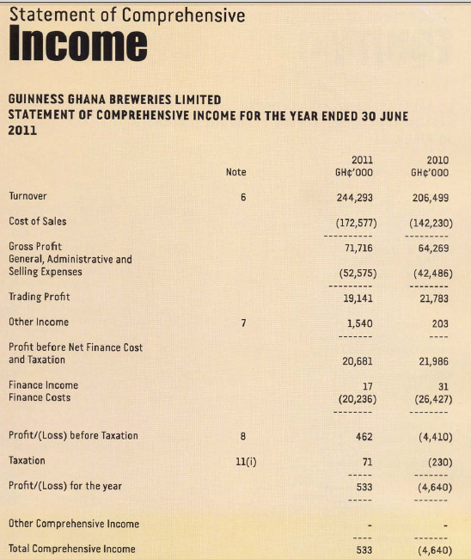

Statement of comprehensive income
Objective: Provides information about the performance of the entity over a period
Elements: income and expenses

Slide 10
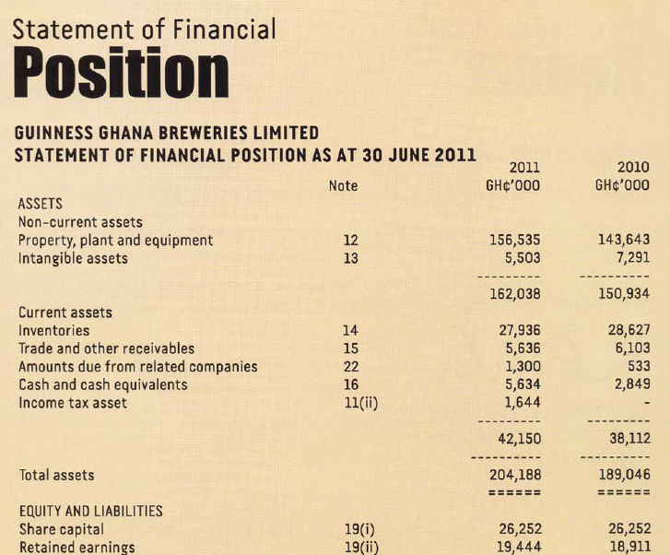
Statement of financial position
Objective: Provides information about the financial position of the entity at a point in time
Elements: assets, liabilities, and equity
A = E + L

Slide 11
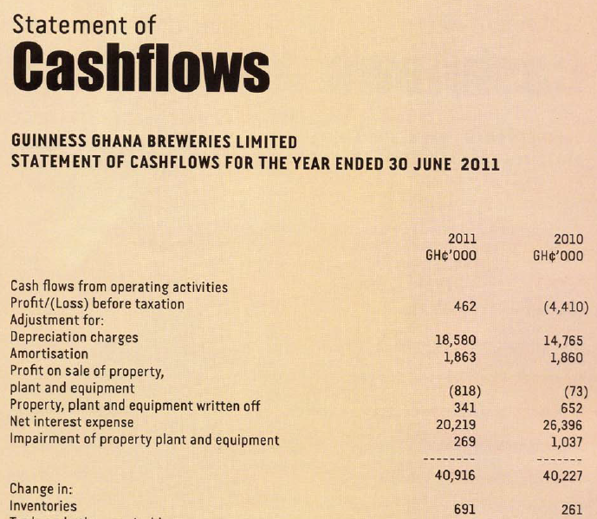
Statement of cash flows
Objective: Provides information about changes in an entity’s financial position during a period
Used to assess operating, investing, and financing activities during a period
Used to assess ability to generate cash and cash equivalents and cash requirements
Elements: all elements

Slide 12
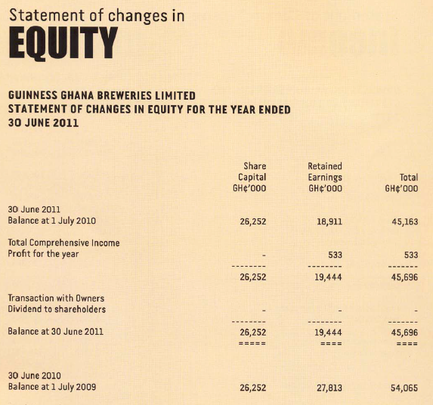
Statement of changes in equity
Objective: Provides information about investments by and distributions to owners in their capacity as owners during a period
Elements: equity

Slide 13
Other reports published in the annual report
Report of the directors
Report of the auditors
Chairperson’s review
Managing director’s review
Corporate governance report
Report of the audit committee
Environmental reports
Value added statement
There are several other reports and analysis that are published in the annual report but do not form part of financial statements

Slide 14
Users and their information needs
Users of general-purpose financial statements
Information needs of users of general-purpose statements
Qualities of users of financial information

Slide 15
Users and their information needs
Investors
Information about risk and return to help decide on buying, holding or selling shares in the entity.
Employees
Information about the stability and profitability of their employers, and to assess the ability of the entity to provide remuneration, retirement benefits and employment opportunities.
Lenders
Information that enables them to determine whether their loans and the interest on them, will be paid when due.
Suppliers and other trade creditors
Information that enables them to determine whether amounts owing to them will be paid when due.
Investors
Employees
Lenders
Suppliers
Customers
Governments and their agencies
Public

Slide 16
Users and their information needs
Customers
Information about the continued existence of the entity.
Governments and their agencies
Information needed for resource allocation, regulation of the activities of entities, determination of taxation policies, estimating national income and similar statistics.
Public
Information about trends and recent developments in the prospects of the entity and its activities
Investors
Employees
Lenders
Suppliers
Customers
Governments and their agencies
Public

Slide 17
Qualities Required of Users
A reasonable understanding and prior knowledge of business and economic activities
A willingness to study the information with reasonable diligence
Financial information is prepared and presented to users on the assumption that they possess these two qualities.

Slide 18
Elements of financial statements
Assets
Liabilities
Equity
Income
Expenses

Slide 19
Elements of financial statements
Directly related to financial position
Assets
Liabilities
Equity
Directly related to performance
Income
Expenses
Income, expenses, assets, liabilities, and equity are the building blocks used in constructing financial statements.

Slide 20
Assets
Economic resources
Probable future economic benefits obtained or controlled by a particular entity as a result of past transactions or events
Definition
Features
Current and noncurrent distinction

Slide 21
Assets
Embodies a probable future benefit.
A particular entity can obtain the benefit and control others’ access to it.
The transaction or other event giving rise to the entity’s right to obtain or control the benefit has already occurred.
Definition
Features
Current and noncurrent distinction

Slide 22
Assets
How the future economic benefits of assets will flow to the entity
Exchanged for cash or other goods and services
Used to produce goods or services
Used to enhance the value of other assets
Used to settle liabilities
Definition
Features
Current and noncurrent distinction

Slide 23
Assets
Current assets
Noncurrent assets
Assets from which future economic benefits are expected to flow to the entity in not more than a year after the reporting period
Assets from which future economic benefits are expected to flow to the entity in more than a year after the reporting period
Definition
Features
Current and noncurrent distinction

Slide 24
Assets
Think about a transaction or event that change assets
Does it increase or decrease a class of assets?
Does it change the value of current assets or noncurrent assets?
Definition
Features
Current and noncurrent distinction

Slide 25
Liabilities
Present obligations
Probable future sacrifices of economic benefits arising from present obligations to transfer assets or provide services to other entities in the future as a result of past transactions or events
Definition
Features
Current and noncurrent distinctions

Slide 26
Liabilities
Embodies a present duty or responsibility to another entity that involves transfer of economic benefits.
The duty or responsibility obligates a particular entity, leaving it little or no discretion to avoid the future sacrifice.
The transaction or other event obligating the entity has already happened.
Definition
Features
Current and noncurrent distinction

Slide 27
Liabilities
How liabilities are settled
Paying with cash
Providing goods or services
Conversion to equity
Staying away from activities that would otherwise bring economic benefits
Waiver by creditor
Definition
Features
Current and noncurrent distinctions

Slide 28
Liabilities
Current liability
Noncurrent liability
Liability that is required to be settled in not more than a year after the reporting period
Liability that is required to be settled in more than a year after the reporting period
Definition
Features
Current and noncurrent distinctions

Slide 29
Liabilities
Think about transactions and events that change liabilities
Does it increase or decreases the entity’s portfolio of liabilities?
Does it change the value of current liabilities or noncurrent liabilities?
Definition
Features
Current and noncurrent distinction

Slide 30
Equity (Net assets)
Equity is the residual interests in assets remaining after deducting liabilities.
Definition of equity
Components of equity
Economic resources owned or controlled
Claims to assets by other entities

Slide 31
Equity (Net assets)
Capital from the owners – resources contributed by owners
Reinvested profits
Definition of equity
Components of equity

Slide 32
Income
Increases in economic benefits which result in increase in equity
Occur in the form of
Reduction in liabilities
Increase in assets
Definition of income
Classes of income

Slide 33
Income
Revenue
Gains
From delivering or producing goods, rendering services, or other activities that constitute the entity’s ongoing major or central operations.
From peripheral or incidental transactions of an entity.
Definition of income
Classes of income

Slide 34
Income
Think about transactions and events that result in income
Does it result in a revenue?
Does it result in a gain?
Definition of income
Classes of income

Slide 35
Expenses
Expenses are decreases in economic benefits that result in decreases in equity
Occur in the form of
Outflows/depletions of assets
Incurrences of liabilities
Definition of expense
Classes of expense

Slide 36
Expenses
Operating expenses
Losses
Expenses arising during ordinary activities
Losses arising from peripheral activities
Definition of expense
Classes of expenses

Slide 37
Expenses
Think about transactions and events that result in expenses
Does it result in an expense during ordinary activities?
Does it result in a loss from peripheral or incidental activities?
Definition of expense
Classes of expenses

Slide 38
Case Analysis
Case Background
“Best African Fabrics is a start-up fashion maker of African clothing lines, handbags, and laptop bags. However, African clothing is the main long-term target of the firm. The clothes are for children and adults of both males and females. To do this, Best African Fabrics intends to use current tools of advertisement such as Facebook, Snapchat among others and, periodic exhibitions to reach a bigger market. Our retail shop would serve as the centre of the market for our products. However, Best African Fabrics intends to create innovative ways to existing African clothes and becoming unique by customer preference designs, quality brands, and market strategies.
Best African Fabrics [will be] well known for producing African clothing with quality yarns that can stand the test of time. [And that would make] our clothing line elegant and multipurpose.”
Read the extract from a student’s project report and do the following:
Identify assets that the business would probably have. Categorize them into current and noncurrent.
Identify liabilities that the business would probably assume. Categorize them into current and noncurrent.
Identify equity that the business would probably have.
Identify items of income that the business would probably earn. Categorize them into revenue and gains.
Identify items of expenses that the business would probably incur.

Slide 39
Lecture on Financial Statements
The End

